Slide 1
Numericals on Paging

Slide 2
Main formulas
Physical Address Space = Size of main memory
Size of main memory = Total number of frames x Page size
Frame size = Page size
If number of frames in main memory = 2^{X}, then number of bits in frame number = X bits
If Page size = 2^{X} Bytes, then number of bits in page offset = X bits
If size of main memory = 2^{X} Bytes, then number of bits in physical address = X bits

Slide 3
For Process-
Virtual Address Space = Size of process
Number of pages the process is divided = Process size / Page size
If process size = 2^{X} bytes, then number of bits in virtual address space = X bits

Slide 4
For Page Table-
Size of page table = Number of entries in page table x Page table entry size
Number of entries in pages table = Number of pages the process is divided
Page table entry size = Number of bits in frame number + Number of bits used for optional fields if any

Slide 5
In general, if the given address consists of ‘n’ bits, then using ‘n’ bits, 2^{n} locations are possible.
Then, size of memory = 2^{n} x Size of one location.
If the memory is byte-addressable, then size of one location = 1 byte.
Thus, size of memory = 2^{n} bytes.
If the memory is word-addressable where 1 word = m bytes, then size of one location = m bytes.
Thus, size of memory = 2^{n} x m bytes.

Slide 6
Calculate the size of memory if its address consists of 22 bits and the memory is 2-byte addressable.
We have-
Number of locations possible with 22 bits = 2²² locations
It is given that the size of one location = 2 bytes
Thus, Size of memory
= 2²² x 2 bytes
= 2²³ bytes
= 8 MB

Slide 7
Calculate the number of bits required in the address for memory having size of 16 GB. Assume the memory is 4-byte addressable.
Let ‘n’ number of bits are required. Then, Size of memory = 2n x 4 bytes.

Slide 8
Calculate the number of bits required in the address for memory having size of 16 GB. Assume the memory is 4-byte addressable.
Let ‘n’ number of bits are required. Then, Size of memory = 2n x 4 bytes.
Since, the given memory has size of 16 GB, so we have-
2n x 4 bytes = 16 GB
2n x 4 = 16 G
2n x 22 = 234
2n = 232
∴ n = 32 bits

Slide 9
Consider a system with byte-addressable memory, 32 bit logical addresses, 4 kilobyte page size and page table entries of 4 bytes each. The size of the page table in the system in megabytes is _____.

Slide 10
Consider a system with byte-addressable memory, 32 bit logical addresses, 4 kilobyte page size and page table entries of 4 bytes each. The size of the page table in the system in megabytes is _____.
Number of bits in logical address = 32 bits
Thus,
Process size
= 2³² B
= 4 GB
Number of Entries in Page Table-
Number of pages the process is divided
= Process size / Page size
= 4 GB / 4 KB = 2^{32 /} 2¹²
= 2²⁰ pages
Thus,
Number of entries in page table = 2²⁰ entries
Page table size
= Number of entries in page table x Page table entry size
= 2²⁰ x 4 bytes
= 4 MB

Slide 11
Solve
Consider a machine with 64 MB physical memory and a 32 bit virtual address space. If the page size is 4 KB, what is the approximate size of the page table?
2
4
8
16

Slide 12
Given-
Number of bits in logical address = 32 bits, Page size = 4KB, Page table entry size = 4 bytes
Process Size-
Number of bits in logical address = 32 bits
Thus,
Process size
= 2³² B
= 4 GB
Number of Entries in Page Table-
Number of pages the process is divided
= Process size / Page size
= 4 GB / 4 KB
= 2²⁰ pages
Thus,
Number of entries in page table = 2²⁰ entries
Page Table Size-
Page table size
= Number of entries in page table x Page table entry size
= 2²⁰ x 4 bytes
= 4 MB
Thus, Option (B) is correct.

Slide 13
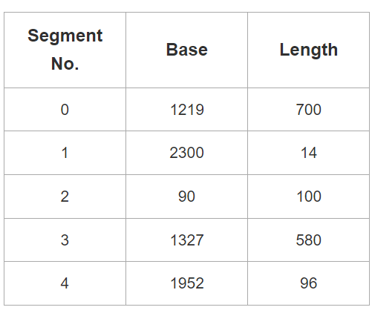
Which of the following logical address will produce trap addressing error?
0, 430

Slide 14
If segment offset becomes greater than or equal to the limit of segment, then trap addressing error is produced.
Here,
Segment Number = 0
Segment Offset = 430
We have,
In the segment table, limit of segment-0 is 700.
Thus, segment offset must always lie in the range = [0, 700-1] = [0, 699]
Now,
Since generated segment offset lies in the above range, so request generated is valid.
Therefore, no trap will be produced.
Physical Address = 1219 + 430 = 1649

